Slide 1
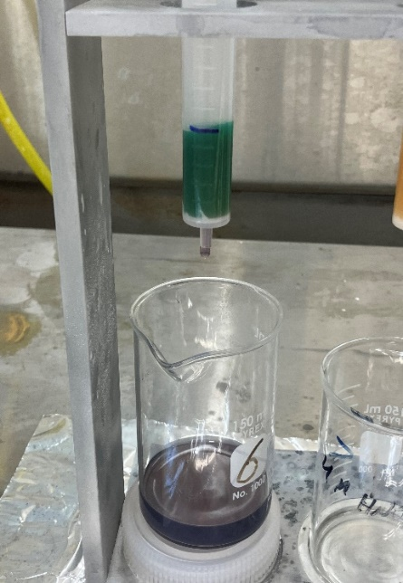

The U.S Department of Energy
Laboratory Accreditation Program &
The Performance Testing Laboratory
Shane Steidley
Radiological and Environmental Sciences Laboratory

Slide 2
Radiological and Environmental Sciences Laboratory (RESL)
  DOE-STD-1111-2018
  DEPARTMENT OF ENERGY LABORATORY ACCREDITATION PROGRAM ADMINISTRATION
    Authorized by DOE to conduct performance testing for DOELAP
    In Accordance with ANSI/HPS N13.30-2011
  DOE-STD-1112-2019
  DEPARTMENT OF ENERGY LABORATORY ACCREDITATION PROGRAM FOR RADIOBIOASSAY
    Points back to ANSI/HPS N13.30-2011 for performance testing criteria

Slide 3
TESTING LABORATORY
  Radiological and Environmental Sciences Laboratory
    ISO/IEC 17025 General Requirements for the Competence of Testing and Calibration Laboratories
    ISO/IEC 17043 assessment - General requirements for proficiency testing
    ISO/IEC 17034 assessment - General requirements for competence of reference material producers
    ANSI/NCSLI Z540.2-R2002, U.S. Guide to the Expression of Uncertainty in Measurements

Slide 4
TESTING LABORATORY
  NIST Traceability
  Application
  Test Plan
  Sample Preparation
  Analytical Verification
  Performance Evaluation

Slide 5
Radiological Traceability Program (RTP)
Direct Traceability to NIST
  RESL prepares PE Materials for confirmatory measurements by NIST
  RESL analyzes PE Materials prepared by NIST
  All Matrices are addressed

Slide 6
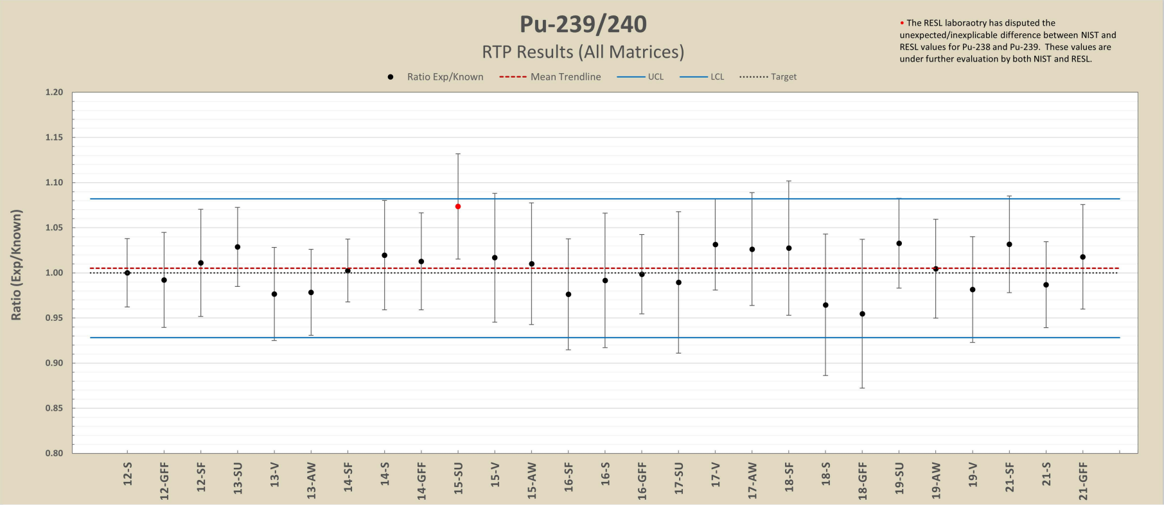

RTP Results (All Matrices)

Slide 7

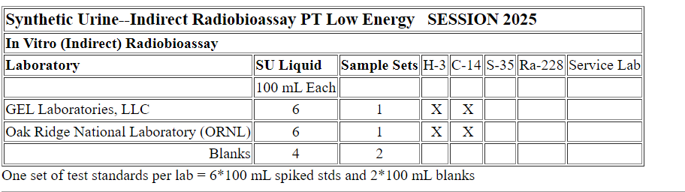
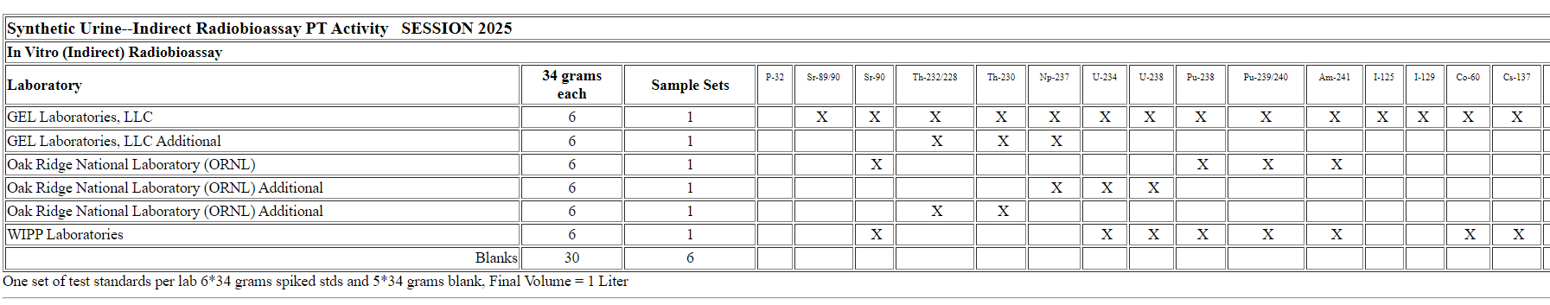
Testing Laboratory
Application
Notes:
Mixed Analyte PE materials

Slide 8
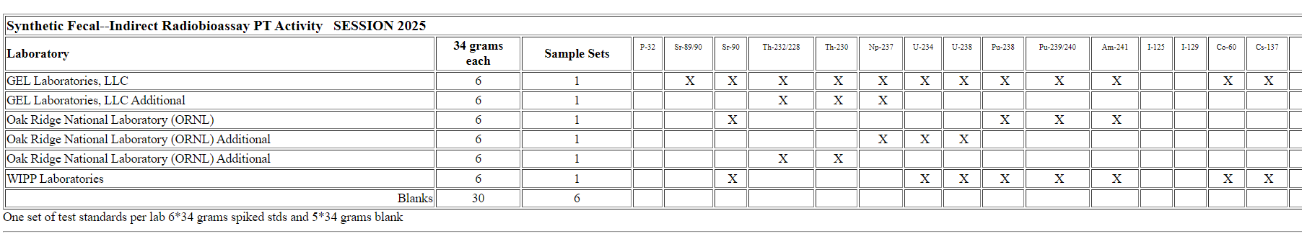
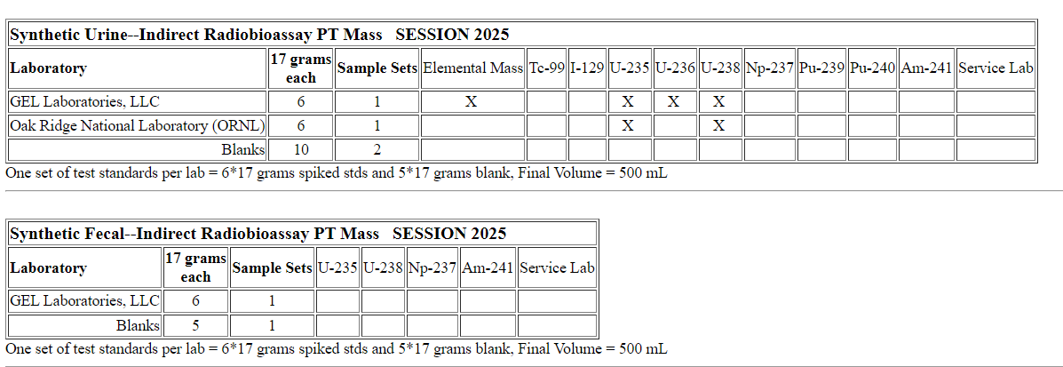
Testing Laboratory
Application
Notes:
Mixed Analyte PE materials

Slide 9
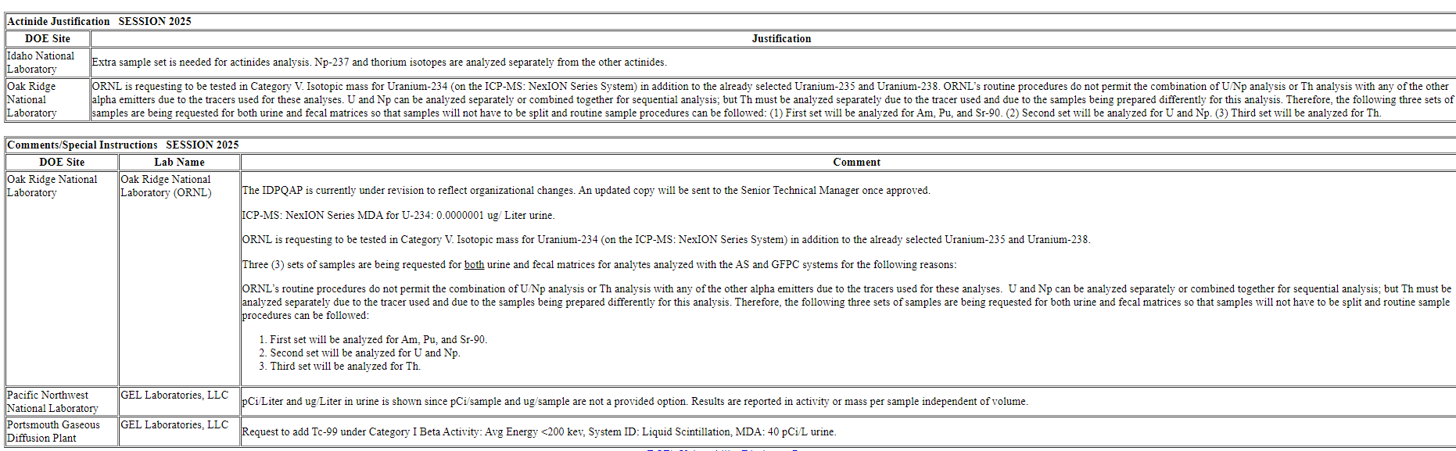
Testing Laboratory
Comments
Notes:
Application- Comments for assessors, you see something not specifically called out in ANSI standard (Tc-99 exa:0
Method needs such as sequential, …. Strings to pull for thoughts of assessment

Slide 10
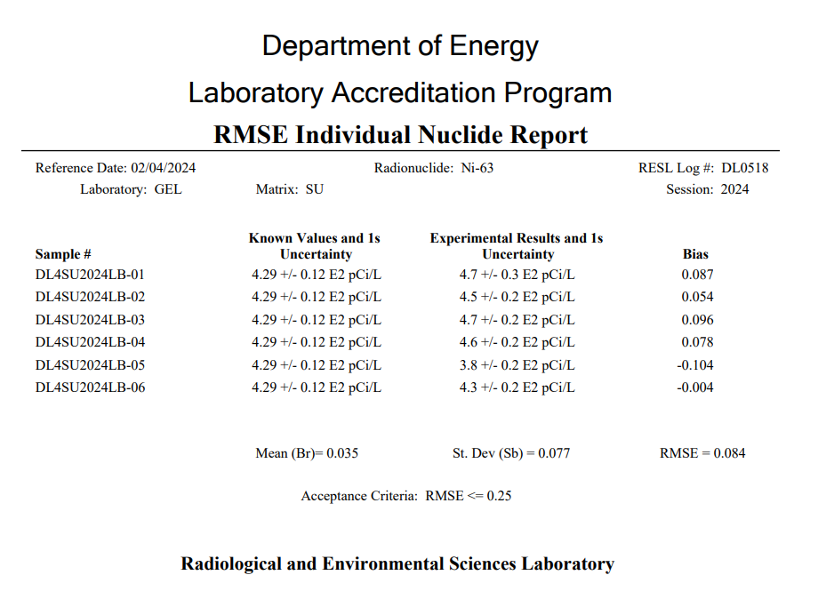
Testing Laboratory
PT tests on non standard ANSI N13:30
  Sm-141, Ni-63, Pu-241, ..
List MDAs for the nuclide of interest in the comments
Test samples based on ~10-20x MDA

Slide 11
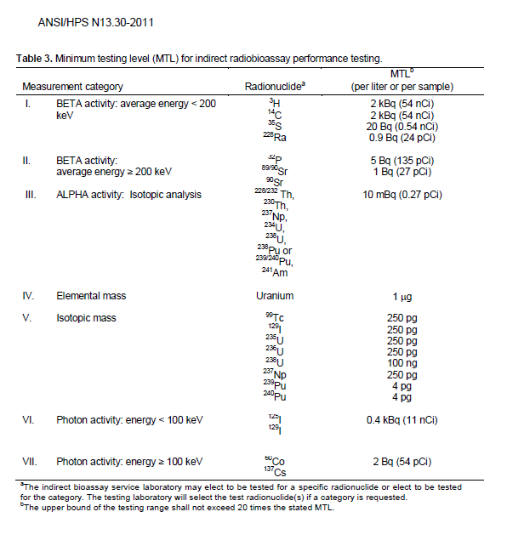
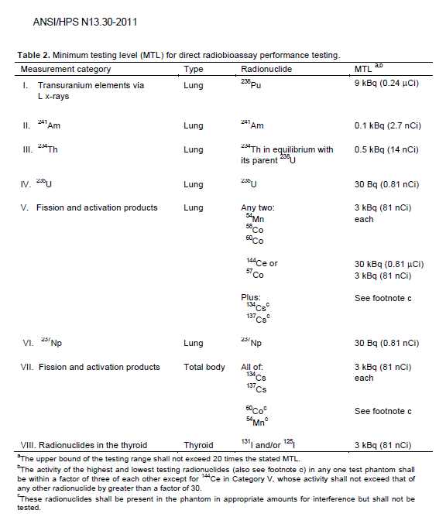
Testing Laboratory
Amounts of activity used in a given test shall be greater than or equal to the MTL and within the range specified in Table 2 or Table 3.
Notes:
PT provider ensures keep within these ranges, for most part.
Some ANSI-revision discussion on ranges;
Two levels for sure we end up drilling into the application for more information: MDA’s, & system descriptions

Slide 12
Testing Laboratory
How are the MTL’s determined
Established on capabilities of competent analysts using well-developed procedures and instruments that should, when properly quality controlled, give reliable results.
A MTL was originally developed based on approximately 10 times the MDA.
MTLs should not be construed with an acceptable MDA.

Slide 13
Direct Radiobioassay Test Phantoms
Testing laboratory shall maintain and provide test phantoms, including appropriate blanks.
The testing laboratory shall identify the test category for each phantom but shall not divulge the activity or the identity of the radionuclide(s)
Kinda hard to do when a category is the radionuclide
The ability of the testing laboratory to measure quantitatively the amount of radionuclide placed in each phantom shall be affirmed by establishing traceability to NIST as described in ANSI N42.22 (1995).

Slide 14
Direct Radiobioassay Test Phantoms
Testing laboratory instructs service laboratory to determine the amount of radionuclide in a phantom in a minimum of five replicate counts using the analytical procedure and counting times normally used for analysis of the radionuclide under consideration and to remove and reposition the phantom after each measurement.
Any deviations from the routine measurement protocol shall be documented in the report to the testing laboratory.

Slide 15
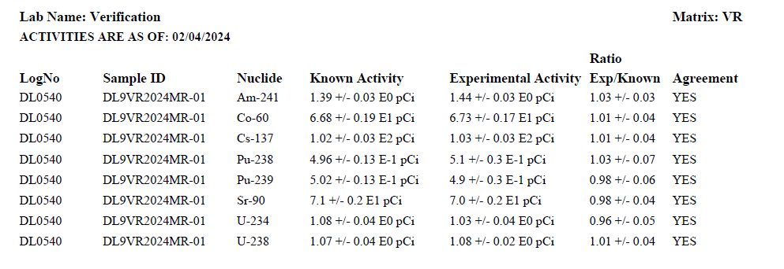
RESL Analytical Verification
Testing laboratory verifies the amount(s) of the radionuclide(s) in the indirect radiobioassay test samples and phantoms.
Notes:
Talk about how RESL does this.

Slide 16
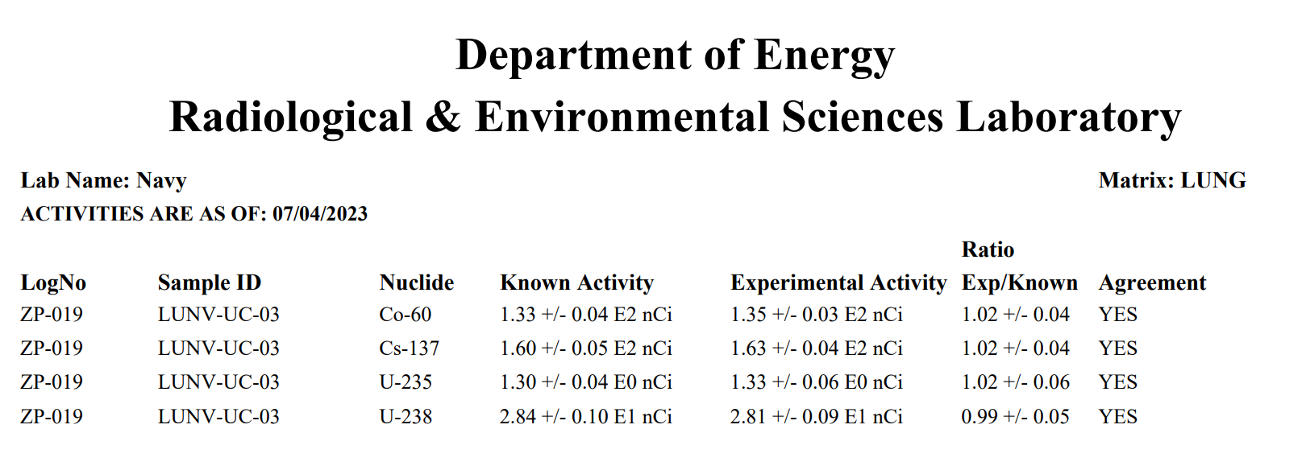
RESL Analytical Verification

Slide 17
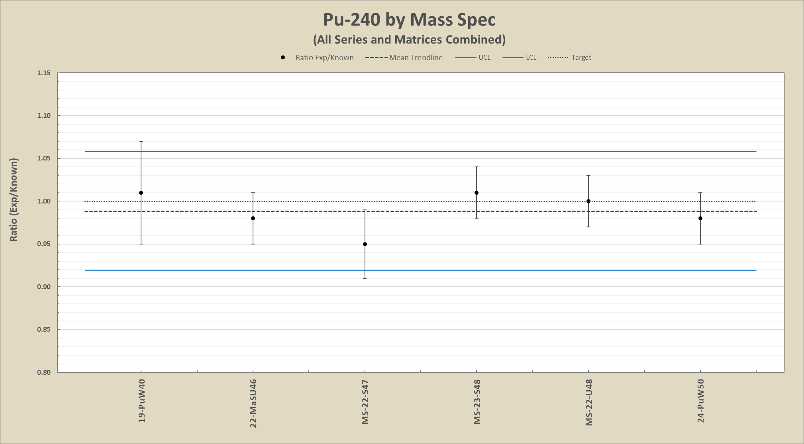
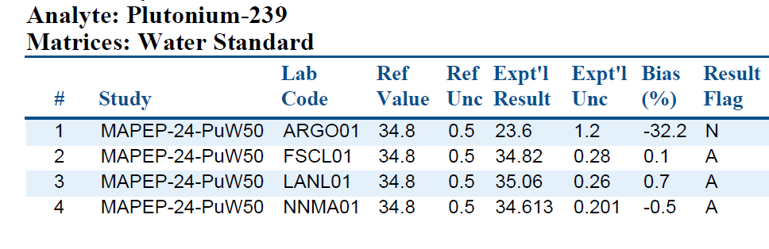
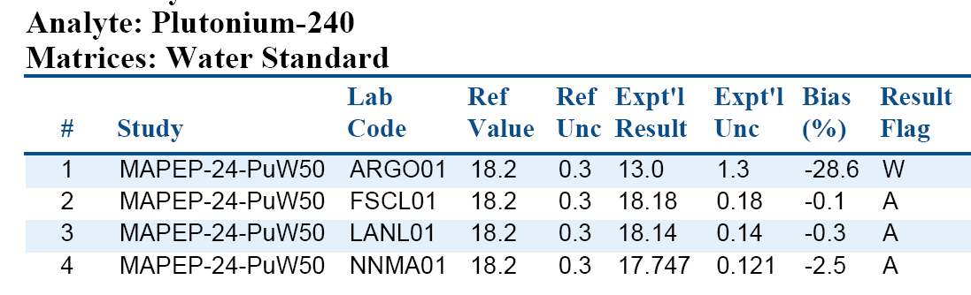
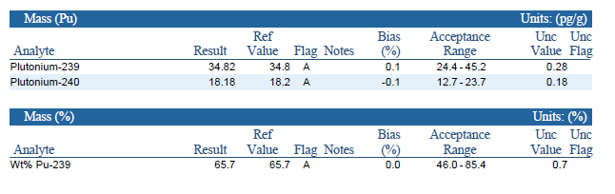
Plutonium Standard Cross Checks

Slide 18
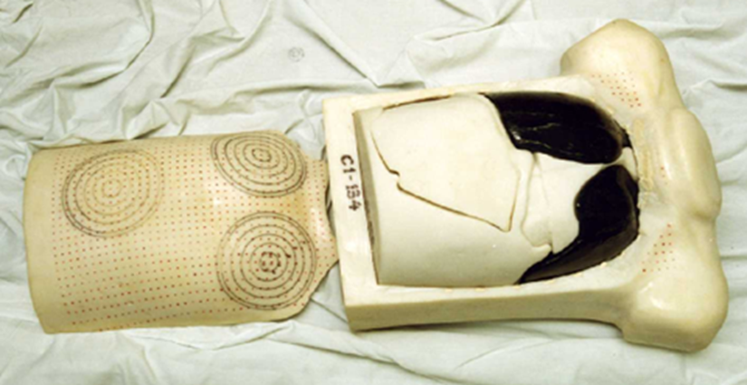
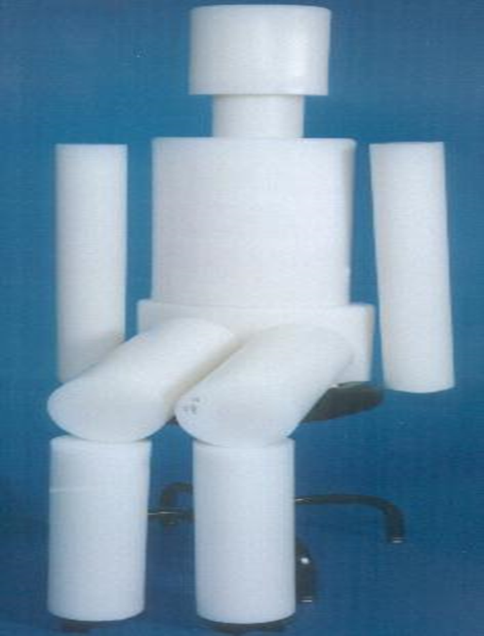
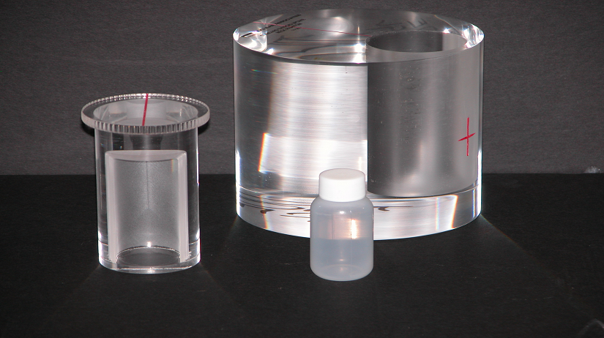
DOE Phantom Library New
New Lungs- Since 2021
  Am-241 (3), MFP (3), Th-Equilibrium (2), Pitchblende (2)
  Am-241 (5), Am-243 (2), EuAm (1), Np (1), MFP (1), Nat U (1), U/Cs,/Co (4)
  Recertifying Lungs (12)
BOMABS
  K-40 (1), Eu-152 (2), MFP (5), Cs-134/137/Co-60 (1)
  2x (MFP, Eu) , 2x( Y, Sb, Eu), 2x (Cs, Eu)
  Multiple in production for Hanford & Japan
  Solid tissue substitute material available
Available Isotopes for SSPEP
  MFP (Co-60, Mn-54, Cs-134/137), K-40, Eu-152/154/155, Sb-125
  MDA for all types with variable counting times
Thyroids
  I-131, I-125 SSPEP available in January
  Ba-133, Sb-125 Available
Notes:
Blind testing or in-house calibrations (Phantom library availability), and resources

Slide 19
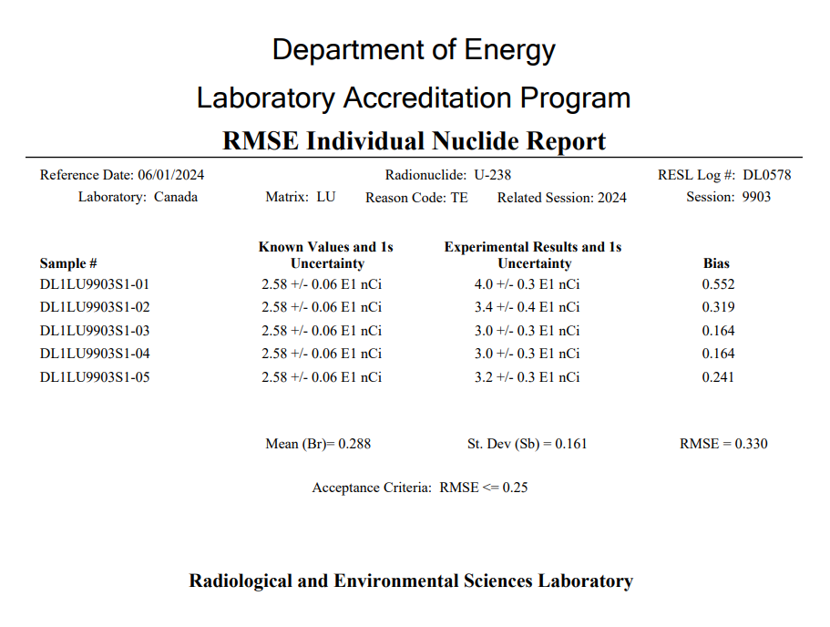
Testing Laboratory
Performance Reports
Notes:
Results for Laboratory Name & associated lab code
No care about Log# RT retestings , Technical Equivelence
Direct: Lung, BOMAB, Thyroid (count 5 times and move/repostion and report 5 values)
Standard 13.30 =: Sqrt(B^2+Sb^2) = RMSE

Slide 20
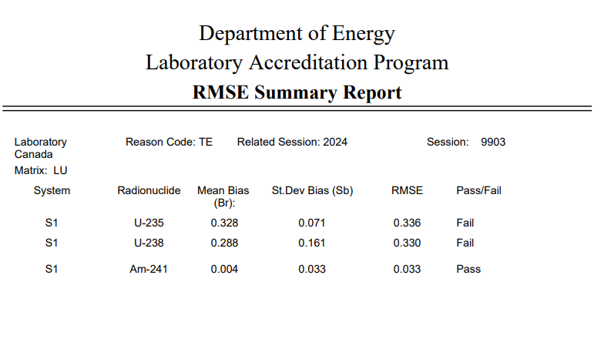
Testing Laboratory
Performance Reports
Notes:
Mixed Analyte PE materials

Slide 21
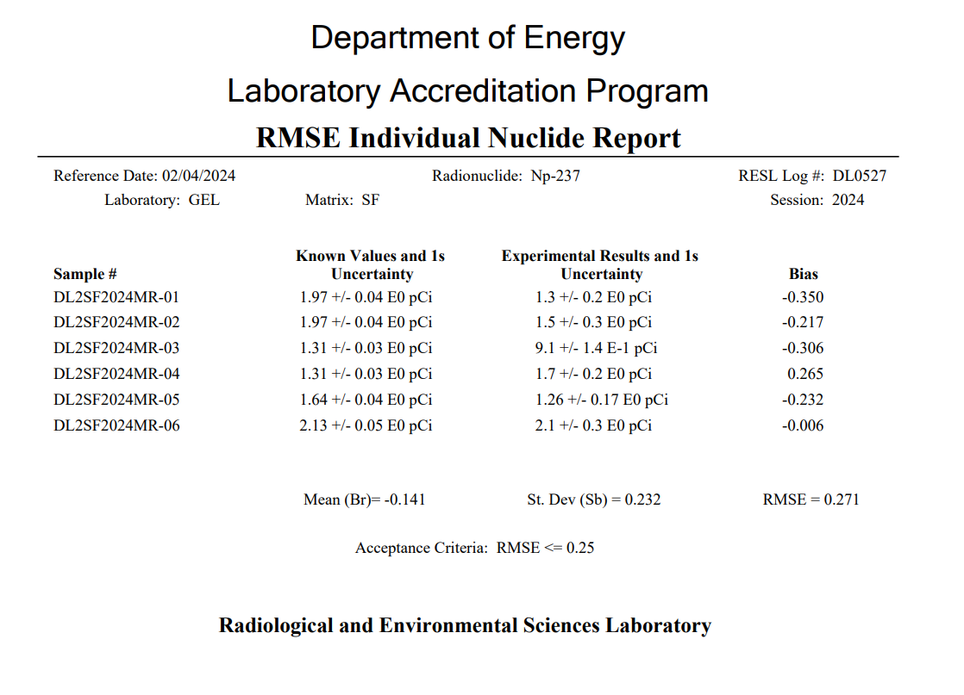
Testing Laboratory
Performance Reports
Notes:
Six samples – Required to report 5 samples
Known values don’t have to be the same, but they can be.
Potential swapped sample

Slide 22
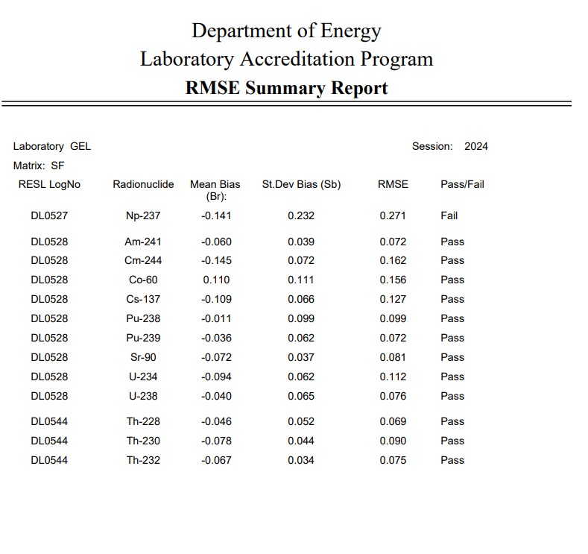
Testing Laboratory
Performance Reports
Notes:
Six samples – Required to report 5 samples
Known values don’t have to be the same, but they can be.
Potential swapped sample

Slide 23
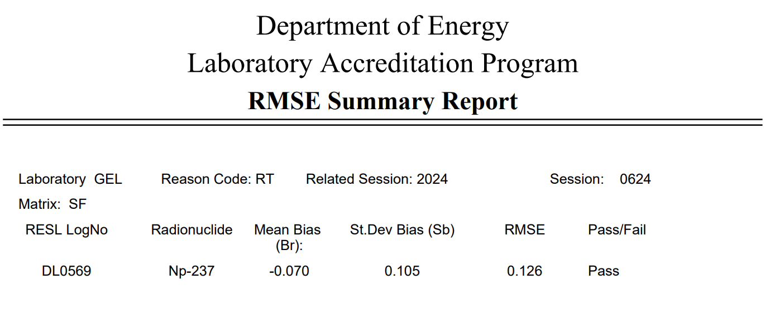
Testing Laboratory
Performance Reports
Notes:
Six samples – Required to report 5 samples
Known values don’t have to be the same, but they can be.
Potential swapped sample

Slide 24
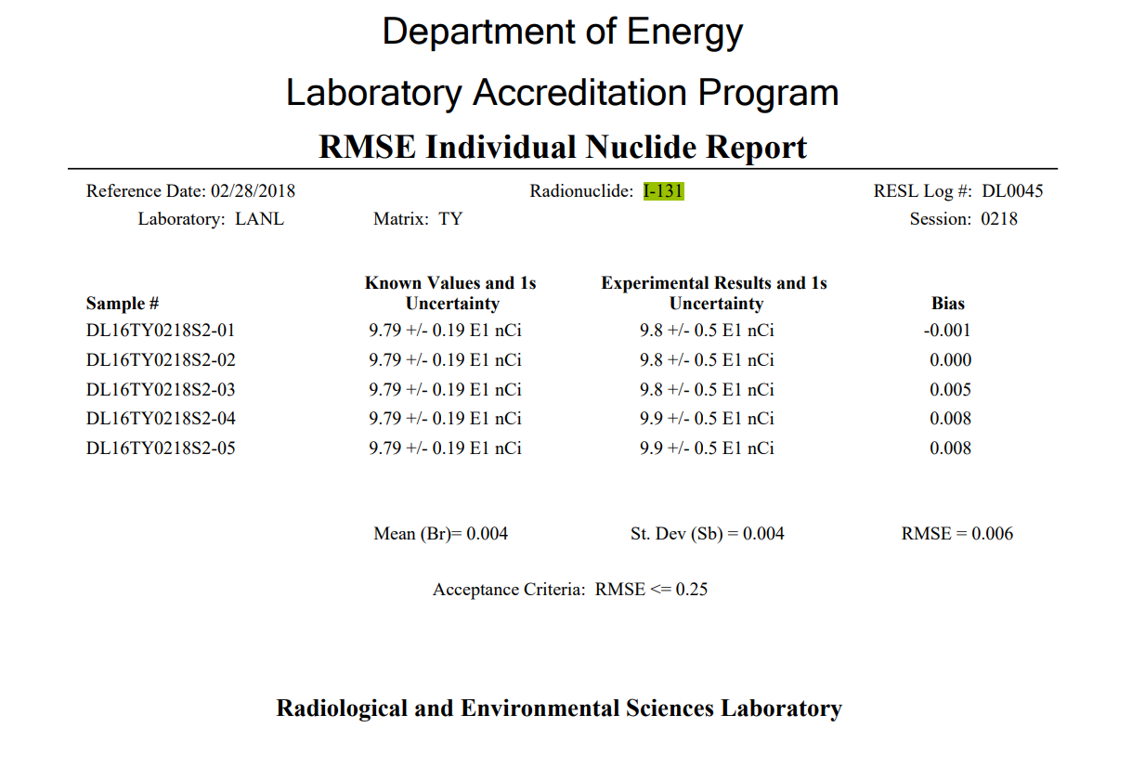
Interesting Facts
Notes:
Laboratory is on the money.

Slide 25
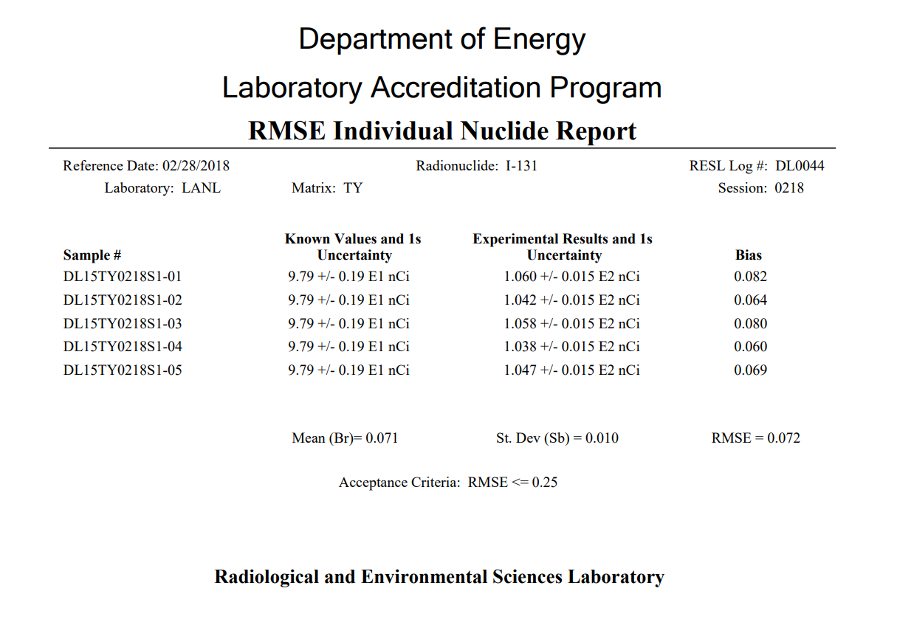
Interesting Facts
Same Laboratory as before. Why is there a 7% bias between systems?

Slide 26
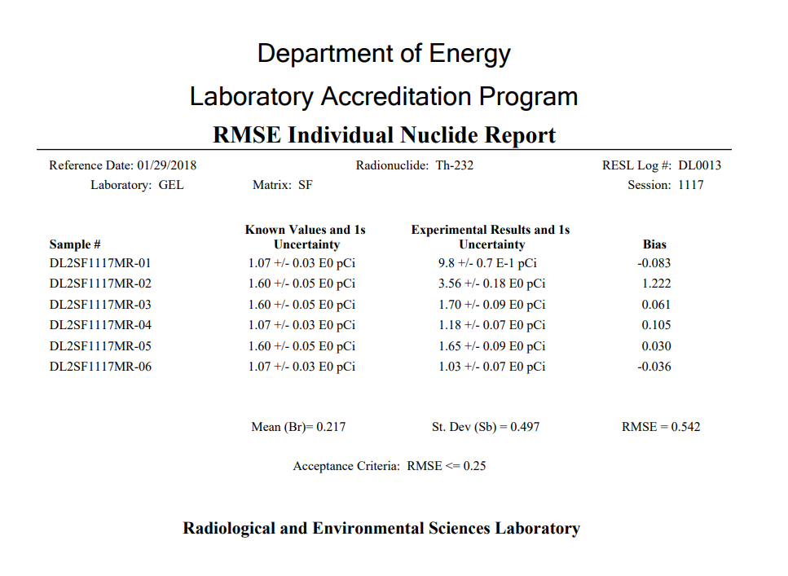
Interesting Facts
Notes:
Lab needs a CAR for PT value, you should be looking at this corresponding CA. Up to the DOLEAP administrator if it’s a good CAR or not.

Slide 27
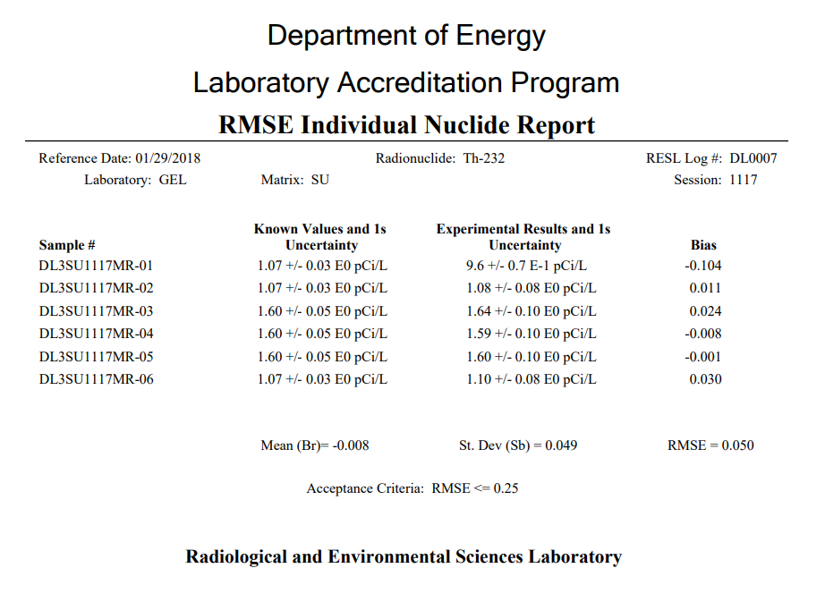
Interesting Facts
Same lab as previous. Shows they can do well on SU so what about fecal?

Slide 28
Interesting Facts
RMC II Known to be biased ~10-15% High

Slide 29
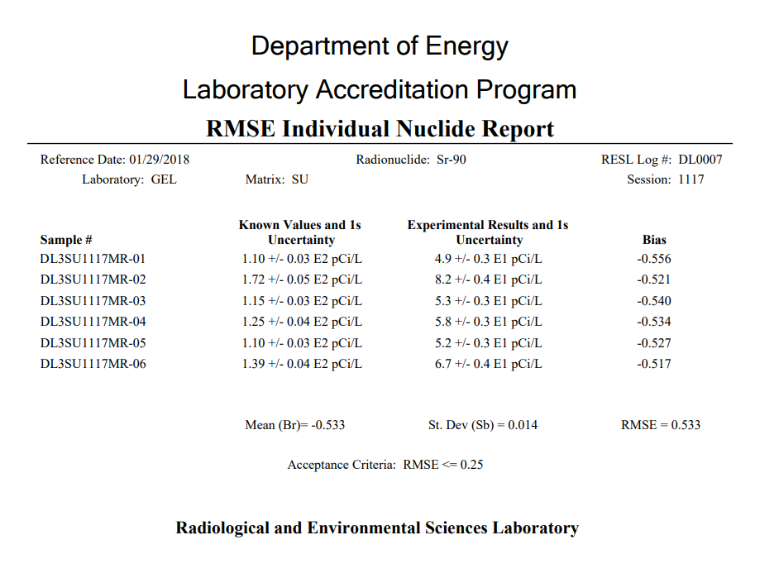
Interesting Facts
Wrong conversions (DPM-pCi).

Slide 30
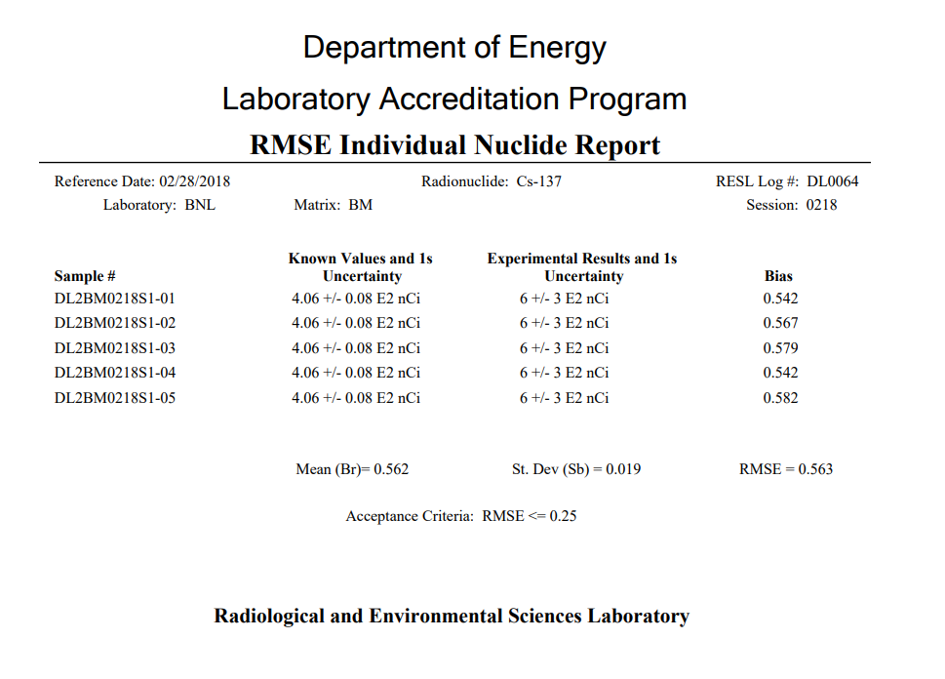
Interesting Facts
Statistical zeros
Using Wrong efficiency file

